Slide 1
A Prototype Device for Facial Electromyography Signal Collection
Final Report
Date: 05/03/2021
Sponsor: Dr. Rose T. Faghih
Project Manager: Dr. Steven Pei
Team 18
Chuong Nguyen (Team Leader) | Toan Vu | Johnathan Nguyen

Slide 2

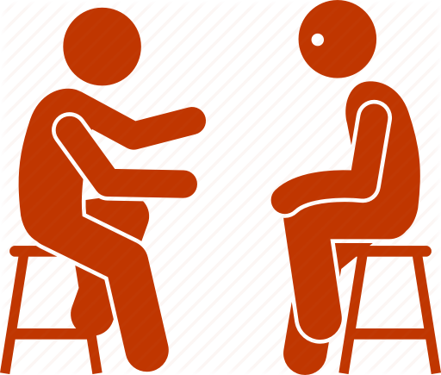

PROBLEMS
70% of adults experience at least one traumatic event
90% of those who die by suicide had a diagnosable psychiatric disorder
Low success rate of Psychotherapy treatment (50%)
EMG Device | 05/03/2021
Notes:
https://www.scottdmiller.com/the-failure-rate-of-psychotherapy-what-it-is-and-what-we-can-do/

Slide 3


NEEDS
A device to provide well-measured data to medical professionals
More accurate diagnosis with better treatment courses for patients
EMG Device | 05/03/2021

Slide 4

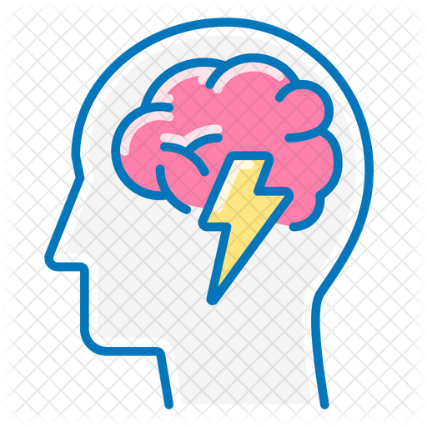
PURPOSE
Detect a person’s emotion by collecting and analysing their electromyography (EMG) signals.
Display the user’s emotion on a mobile application.
EMG Device | 05/03/2021

Slide 5
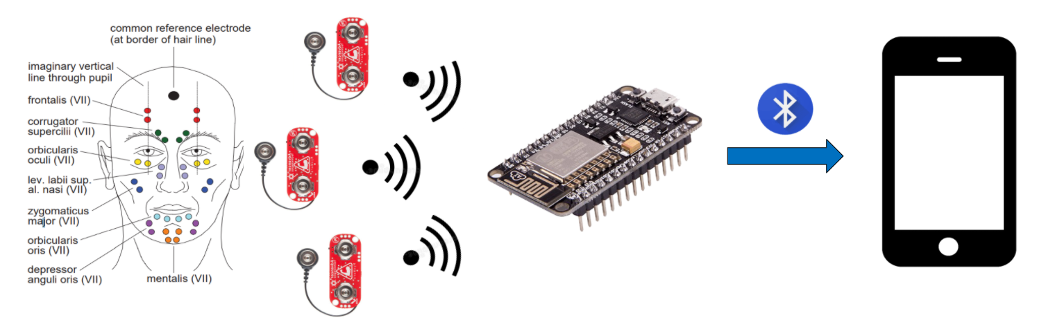
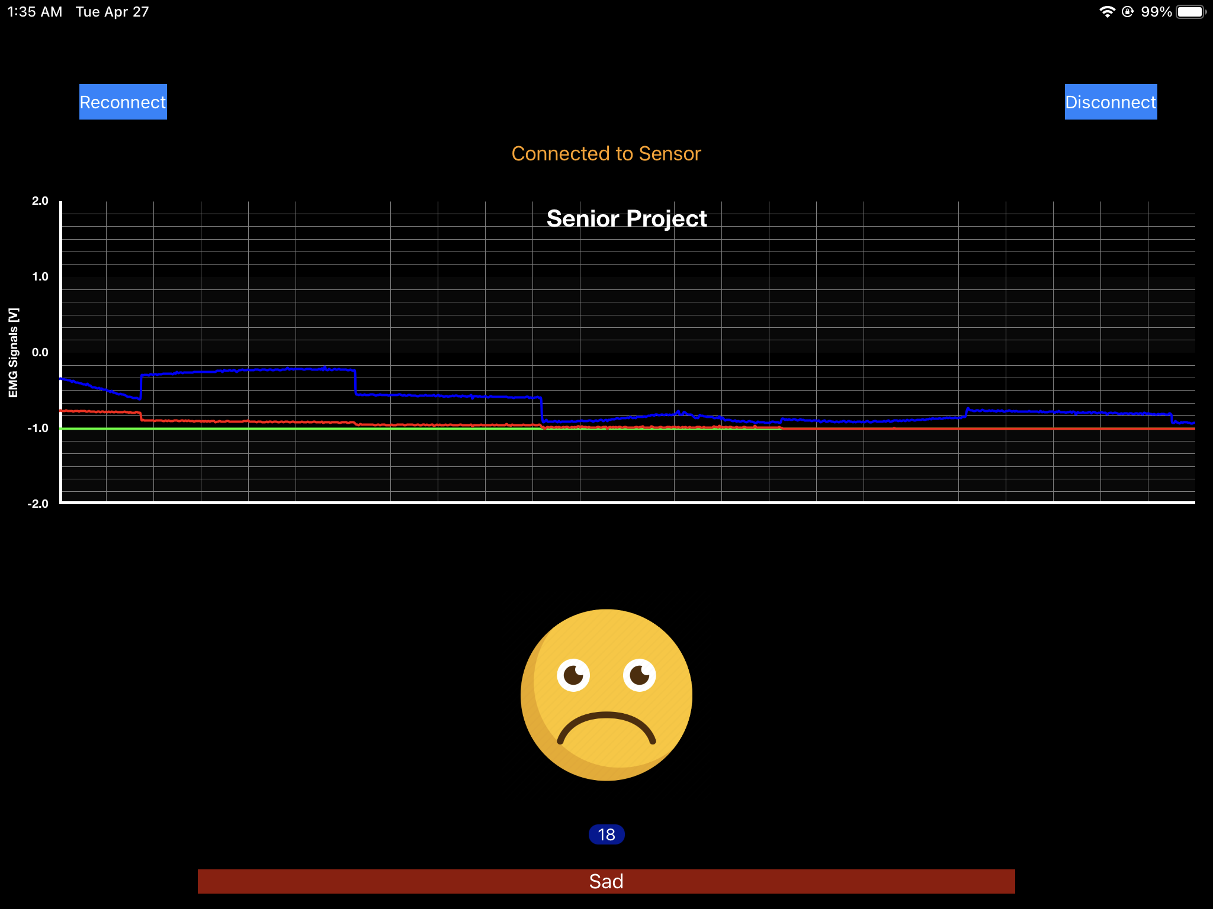
OVERVIEW DIAGRAM
EMG Device | 05/03/2021

Slide 6
PATENTS
US 8214214 B2
Emotion detection by analyzing the user’s prosody (rhythm and intonation of voice)
US 9600715 B2
Emotion detection by analyzing raw image data of a user’s facial expression
US 8170656 B2
Detecting the gestures of parts of body by analyzing the EMG signals
EMG Device | 05/03/2021

Slide 7
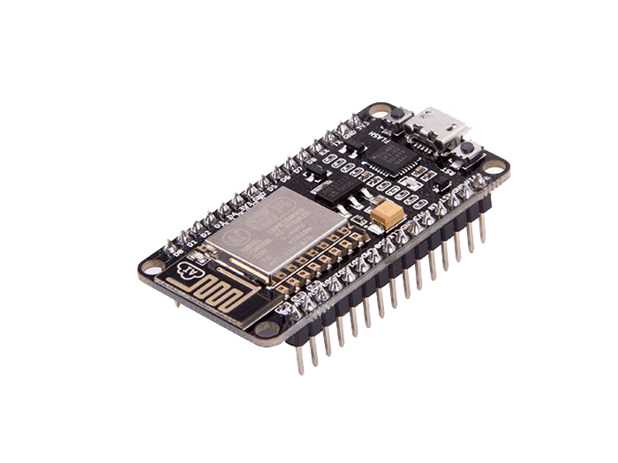


DELIVERABLES
Microcontroller Programing
Machine Learning Model
iOS Mobile Application
EMG Device | 05/03/2021

Slide 8
ENGINEERING SPECIFICATIONS
Bluetooth Connectivity | Bluetooth Low Energy (BLE) Range: 2-3 meters
Sampling Frequency | 1 [KHz]
Sensors | 3 Myoware Muscle Sensors
Power Consumption | 127 [mAh]
Machine Learning | TensorFlow, Recurrent Neural Network, Long-Short Term Memory
Machine Learning Model | 90% Accuracy
Emotion Predictions | 70% Accuracy
EMG Device | 05/03/2021
Notes:
Tensorflow is a Python library specialized in Machine Learning. Because data read from the sensors is sequential, we’ve built our machine learning model based on Recurrent Neural Network and Long-short term memory structure because these types of neural network can process sequences of continuous data
We expect to achieve 90% of accuracy from the machine learning model.
Sampling Frequency: Several authors have suggested that the highest frequency components of the EMG signal are around 400-500 Hz [19], [20]. To follow the Nyquists rate, a smapling rate at least, 800-1000 Hz is needed to avoid aliasing and other signal distortion [21].
(https://core.ac.uk/download/pdf/96919379.pdf)

Slide 9
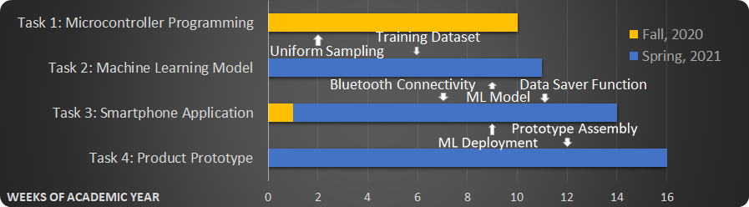
ORIGINAL SCHEDULE

Slide 10
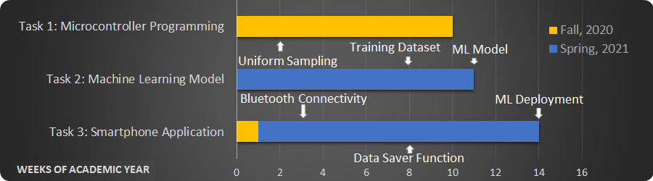
UPDATED SCHEDULE

Slide 11
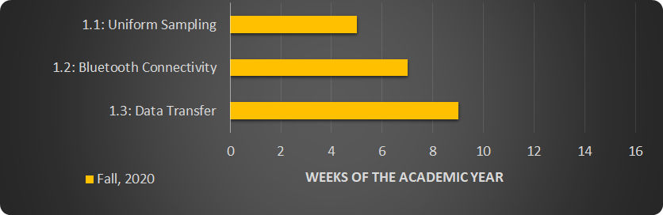
TASK 1: Microcontroller Programming

Slide 12
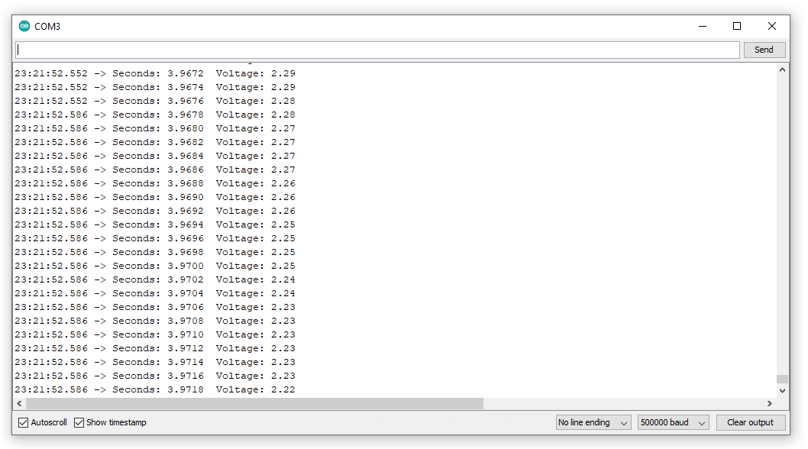
TASK 1: Test Plan and Result
Uniform Sampling: Check the number of samples per second
Bluetooth Connectivity: Expected range is 2-3 meters. Test to see how far the device can go before disconnecting

Slide 13
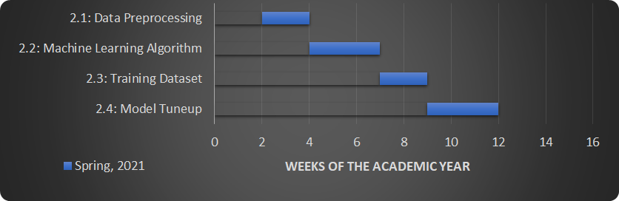
TASK 2: Machine Learning Model

Slide 14
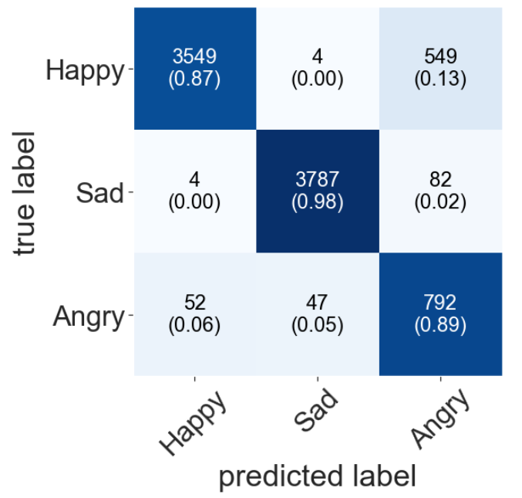
TASK 2: Test Plan and Result
Test plan:
Test with separate datasets to check the accuracy.
Expected accuracy is 90% on the testing stage
Performance:
2,033,500 data points recorded
Training Accuracy: 88.97%
Testing Accuracy: 91.68%

Slide 15
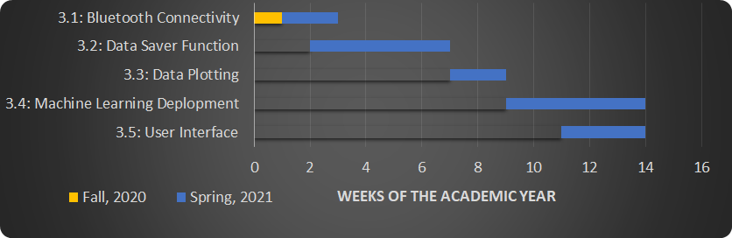
TASK 3: Smartphone Application

Slide 16
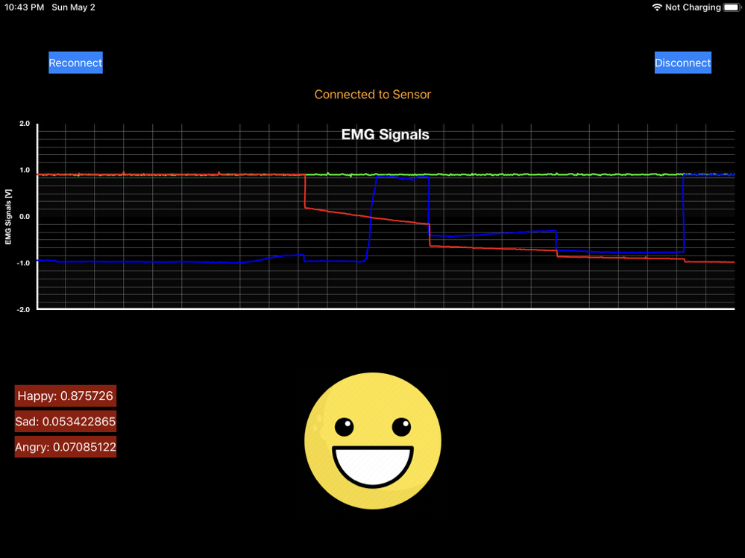
TASK 3: Test Plan and Result
Data Collection and Visualization
Data Saver Function: Check to see if data is properly and efficiently stored in local memory
Test the model deployment on a subject
Performance:
Accuracy on the test subject: 70%

Slide 17
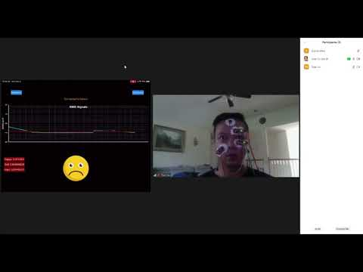
PROJECT DEMONSTRATION
EMG Device | 05/03/2021

Slide 18




CONSTRAINTS
EMG Device | 05/03/2021

Slide 19
RISKS MANAGEMENT
5
 |  |  |  | Task 2.2
 |  | Task 2.4 | Task 2.3
Probability
4
High-risk Task:
Task 2.2 (ML Algorithm): High sensitivity to changes
Mitigation Plan: improve the accuracy by adding more samples to the training dataset, generalize the input sequence, and tuning up the training parameters of the model.
3
2
1
1
2
3
4
5
Consequence
EMG Device | 05/03/2021
Notes:
training Parameters:
Number of Layer in the Neural Network
Number of Neurons in each layer
Learning rate
Number of epochs to train the model,

Slide 20
RISKS MANAGEMENT
5
 |  |  |  | Task 2.2
 |  | Task 2.4 | Task 2.3
Probability
4
Medium-risk Tasks:
Task 2.3 (Training dataset): The credibility of the dataset is affected while collecting
Mitigation Plan: Record samples under various circumstances so that the Machine Learning Model can learn about the differences
3
2
1
1
2
3
4
5
Consequence
EMG Device | 05/03/2021
Notes:
training Parameters:
Number of Layer in the Neural Network
Number of Neurons in each layer
Learning rate
Number of epochs to train the model,

Slide 21
RISKS MANAGEMENT
5
 |  |  |  | Task 2.2
 |  | Task 2.4 | Task 2.3
Probability
Low-risk Tasks:
Task 2.4 ( ML Model Tune-up): Constrained by personal computer’s computability
Mitigation Plan: Use cloud computing instead of personal computers.
4
3
2
1
1
2
3
4
5
Consequence
EMG Device | 05/03/2021

Slide 22
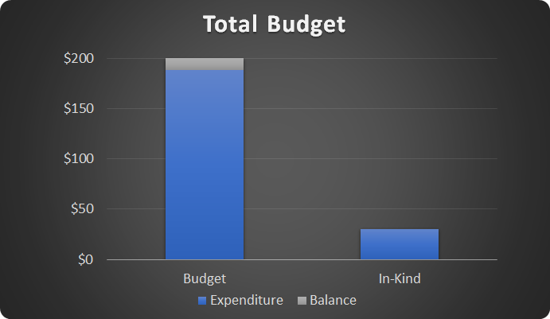
BUDGET
EMG Device | 05/03/2021

Slide 23
EXPENDITURES
Parts | Cost
Microcontroller ESP32 (x2) | $23.80
MyoWare Muscle Sensor (x3) | $123.24
Non-Gelled Reusable Electrodes (x10) | $16.24
Gelled Electrodes (x100) | $19.14
Conductive Adhesive Gel (x1) | $5.72
Total | $188.14
EMG Device | 05/03/2021

Slide 24
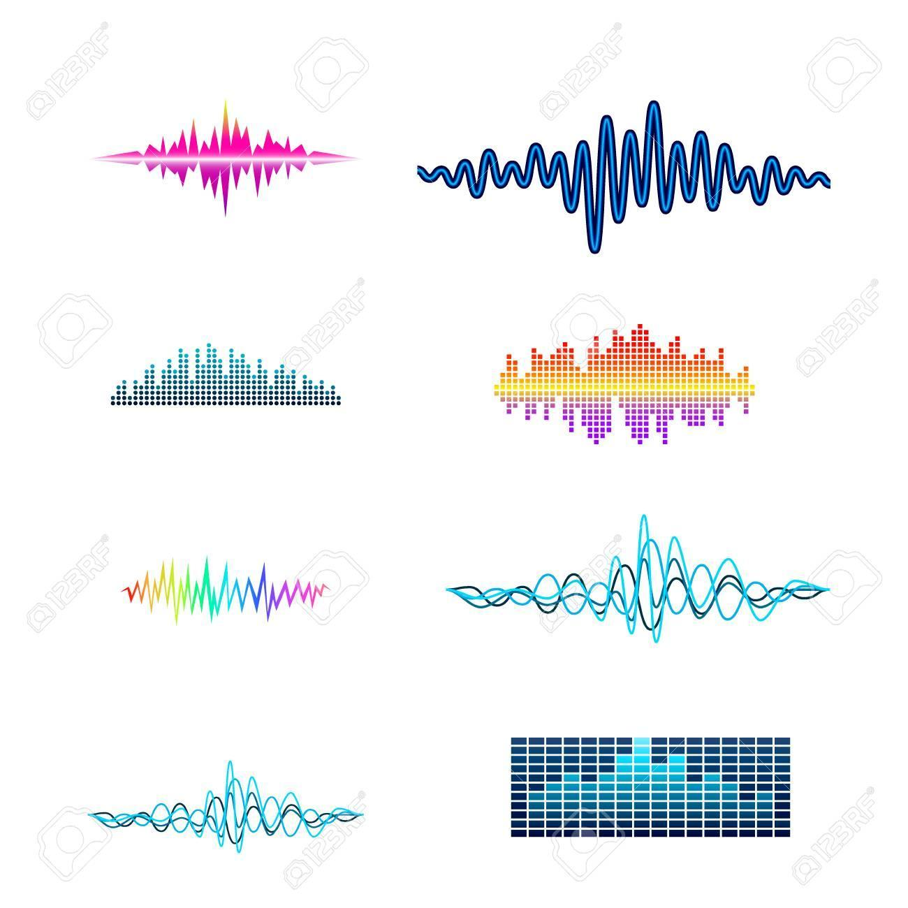



SUMMARY
Major Accomplishments:
Setbacks:
Lessons Learned:
EMG Device | 05/03/2021

Slide 25
ACKNOWLEDGEMENT
Special thanks to our support:
Sponsor: Dr. Rose T. Faghih
Mentor: Md. Rafiul Amin
Project Manager: Dr. Steven Pei
University of Houston: Computational Medicine Lab
EMG Device | 05/03/2021

Slide 26
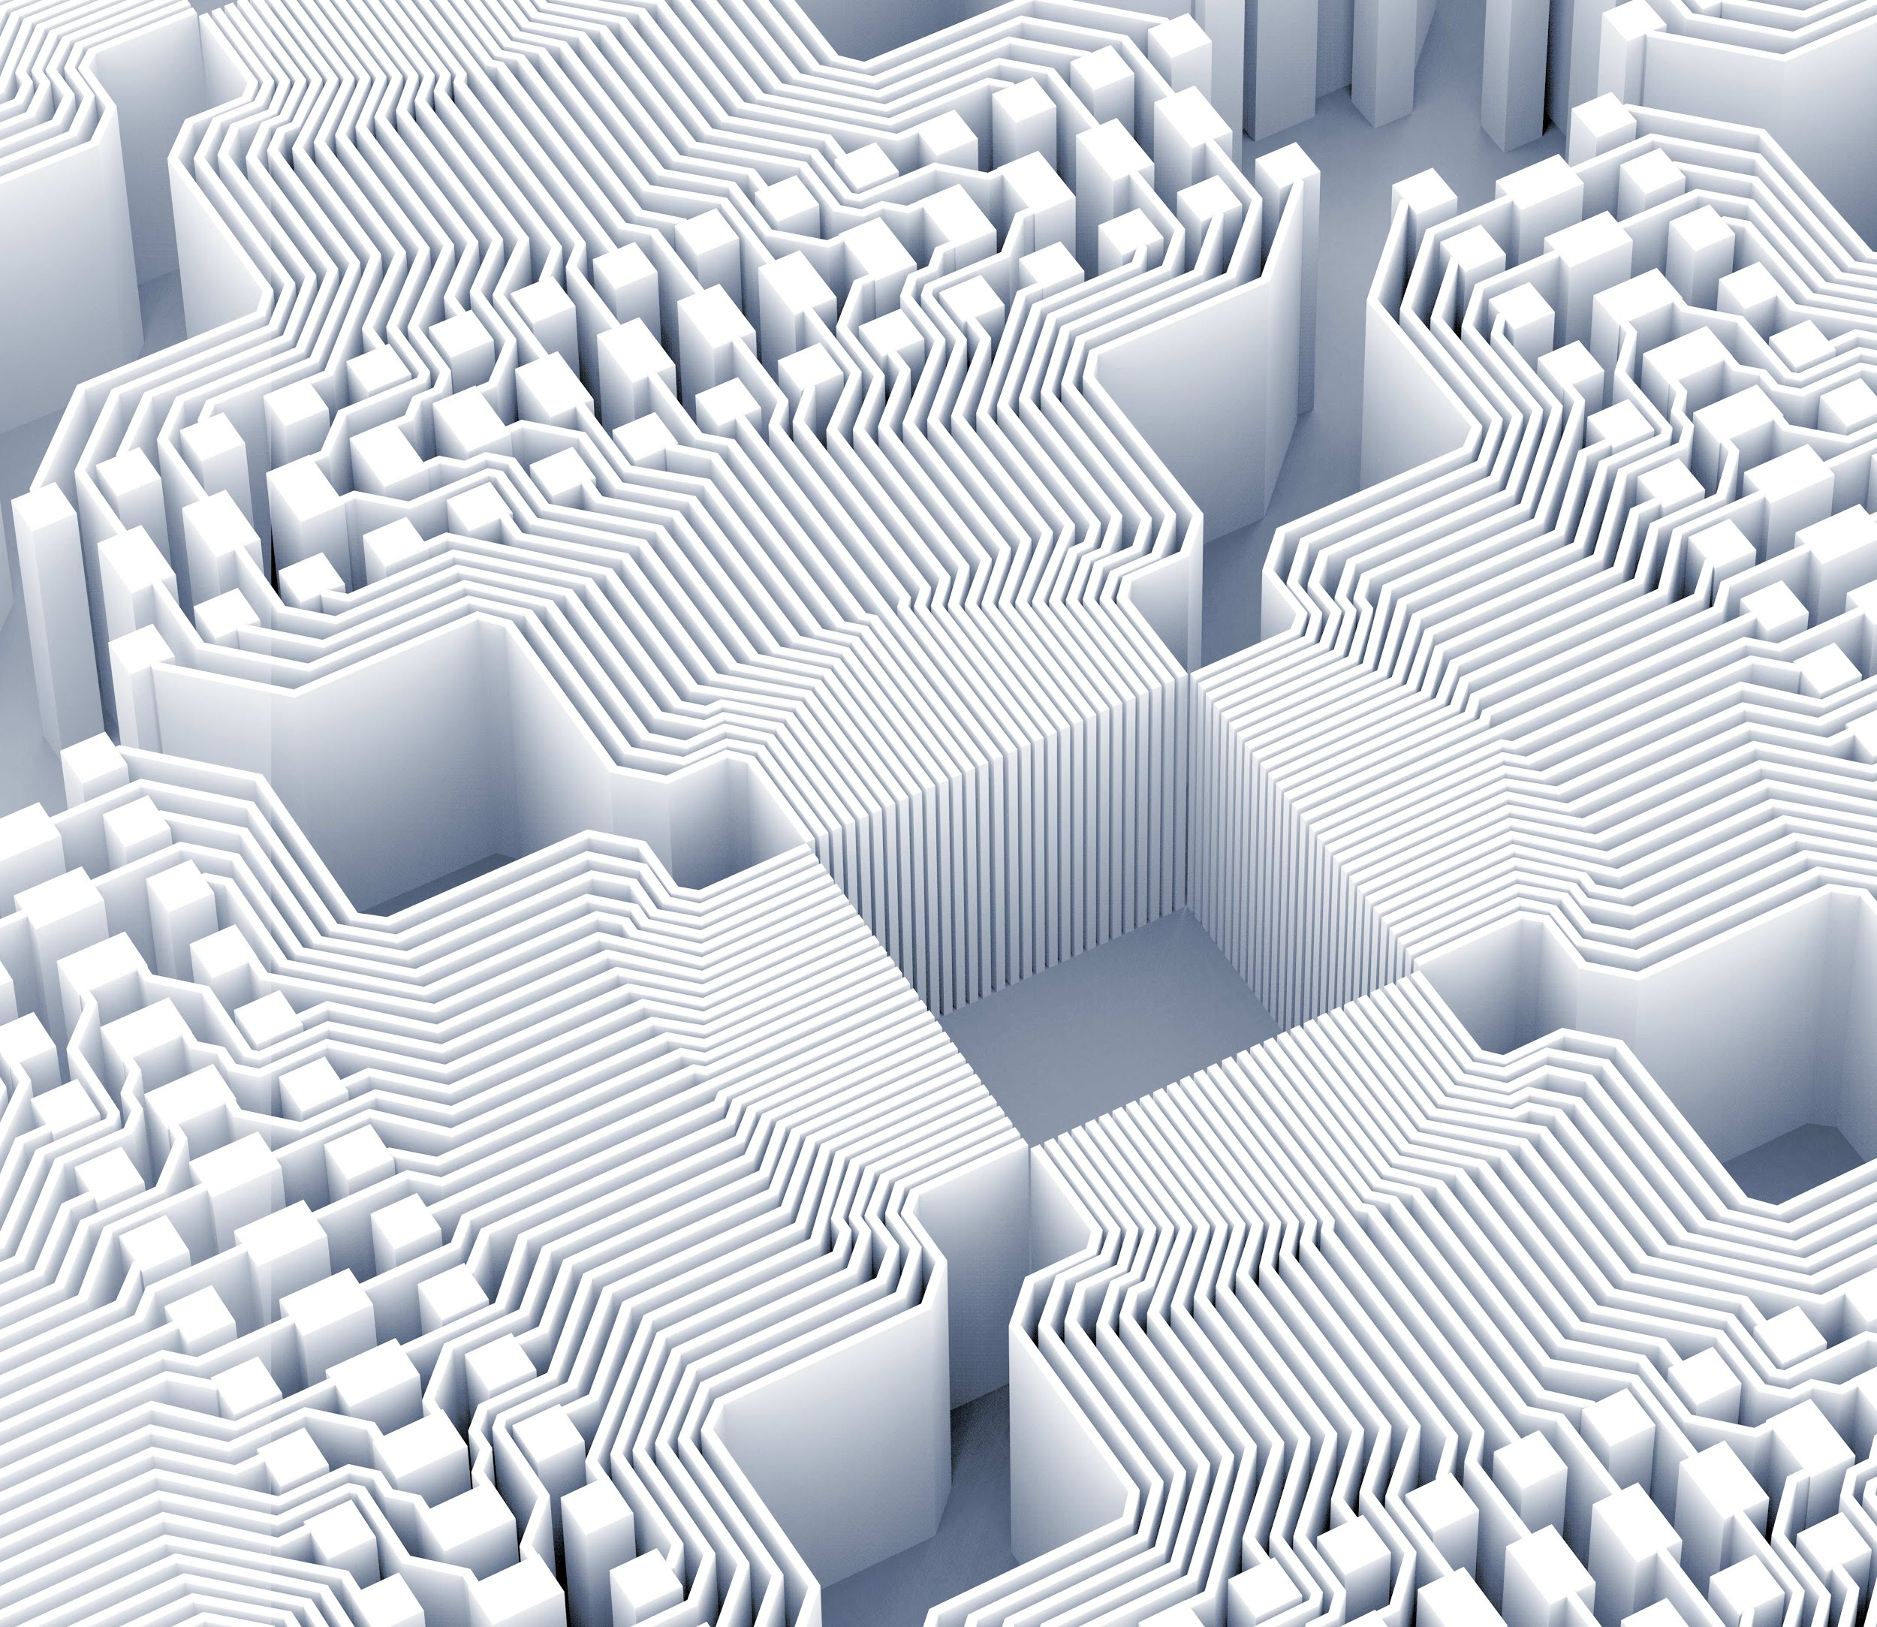
Thank you!
Questions?
EMG Device | 05/03/2021

Slide 27
SUGGESTIONS
3D unobtrusive wearable
Battery (18650 rechargeable battery 3.7V-2500 [mAh])
Larger dataset
Better sensors
Cloud database

Slide 28
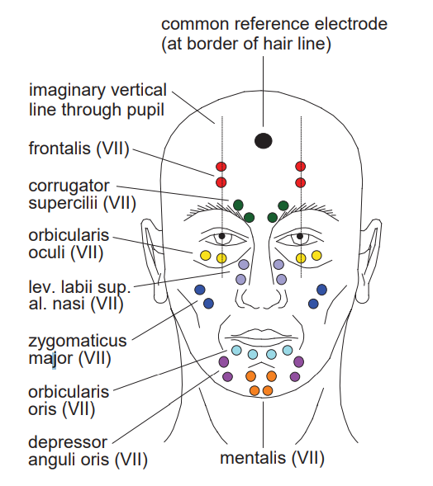
Facial Electrode Locations
Electrode locations for measuring facial EMG activity
EMG Device | 05/03/2021

Slide 29
REFERENCES
https://www.therecoveryvillage.com/mental-health/ptsd/related/ptsd-statistics/
https://afsp.org/story/cdc-releases-new-mortality-data-nation-s-largest-suicide-prevention-organization
https://www.dbsalliance.org/education/depression/statistics/
https://www.scottdmiller.com/the-failure-rate-of-psychotherapy-what-it-is-and-what-we-can-do/
A. Van Boxtel, “Facial EMG as a Tool for Inferring Affective States,” vol. 2010, no. Figure 3, pp. 104–108, 2010.
EMG Device | 05/03/2021

